Slide 1
Case Study
Gonzalo E. Hernández
Marketing Data Analyst
Octubre 2024

Slide 2
My Journey
Teacher, Trainer
Since 14Y ago, had several teaching experiences from 1.1 school support to University lectures on Design Thinking, Creativity & Product Design
Analytics Consultant
2Y Managing clients translating requirements into actions.
Team Player
Problem Solver
Stakeholder Management
Fast-Changing Environments
Finance team lead
For 3 years, led finance team of a NGO focusing on Planning, Negotiation & Measurement.
Data Scientist
1.5Y leading R&D Squads, Modelling, Attribution & AI projects for Youtube, Nestle among others
Notes:
Contar l final la historia de fun fact y que demuestra. SOS INGENIERO. PODES DECIRLO EN LA PARTE DE QUE FUISTE PROFE EN LA FACU
NGO

Slide 3
Challenge
How can we enable GoStudent to grow sustainably?
Initially the campaign had very good reception with high Conversion Rates, but then downturned month after month…
…At the same time, costs have been increasing, putting pressure on profitability.
What opportunities arise?
Notes:
Al principio todo joya, nos iba bárbaro. Pero después, pimba. Este es el enganche
We will assess Mix, Behavior of each Marketing Source Funnel & Sales Performance to inform business stakeholders ways to positively impact Revenue & Profitability

Slide 4






Unlocking Opportunities: 5 Findings to Drive Strategic Decisions
Investment has been profitable until Feb, but opportunities need to be seeked as drop in main KPIs threaten the sustainability of the business.
Channel Strategy (&Mix) needs to be revisited. Meta represents an increasingly less attractive investment option while Google is the best across all kpis (CAC, CR, CR_FT, ROAS (2nd) and ROI)
Commercial Strategy needs to be revisited. Pricing & Duration of offers require assessment per type of student. Prioritization of calls by channels could be improved through data analysis.
Leads efficiency: There are Leads that have not been called even once. Moreover, they are mainly from Google (high CR%).
New Pockets of Growth: how to improve (a decreasing) low funnel conversion? e.g. engage teachers to encourage students to continue?
Notes:
Leer el título, opportunieties together.
META struggles to convert in lower funnel, students dont stay after trial, which is terrible cause we have invested in the whole funnel by that time.
Just look at the number of Leads who took the FreeTrial (CR_leads) and the number of Leads who took the class and signed up for the service (CR_FT). Let's complete with the overall CR, i.e. the % of Leads that became customers. What we see is a general downward trend, which makes sense, since at the beginning of our campaign we are impacting more interested users, which means that over the following months, we will be left with less convinced users, and this means that the transition to customers is not so direct. However, the quality of Leads obtained by Google is the best, as it has the best CR and CR_FT.
Tenemos todas estas oportunidades: cual es el rol de data? Cuál es nuestro rol?

Slide 5
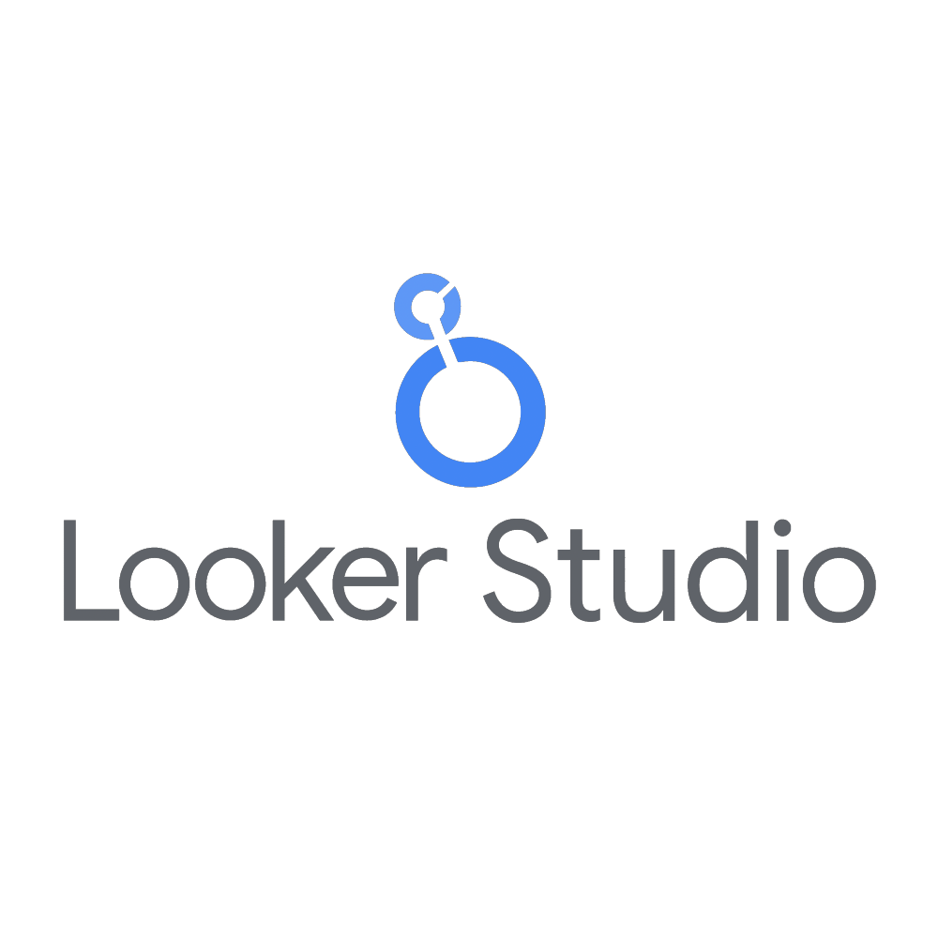
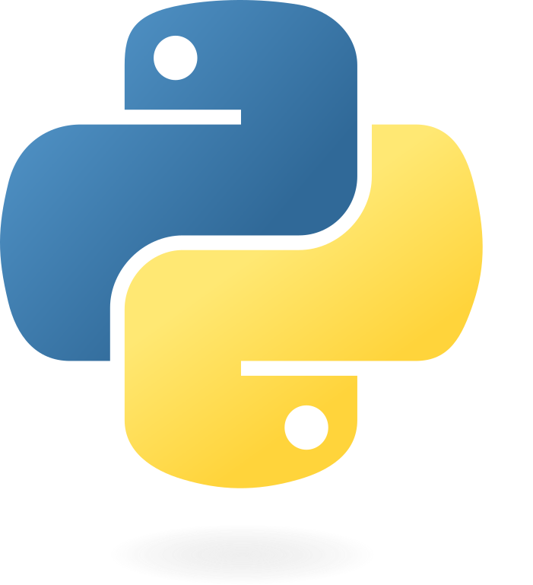
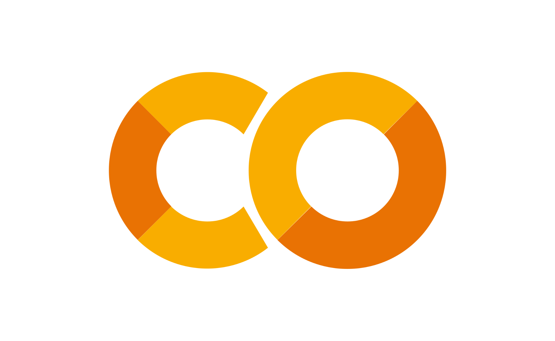
Measurement is vital
Main KPIs to consider
Tools:
As this case requires understanding deeply different Marketing channels’ behavior, will be key to comprehend the End-to-End ‘Student Funnel’ and its profitability.
The KPIs that will allow us to do so will be Conversion Rate and Return of Investment (both advertisement (ROAS) and E2E (ROI)).
Revenue estimation using CLTV and Behavior of Costs throughout time (Monthly Costs per phase a.k.a. CAC and LAC) will be auxiliary KPIs to build solid advice to Marketing and Commercial areas.
Finally, Performance/Efficiency of Sales Teams, affecting CR% and ROI, can be further analyzed through Uncalled Customers, Avg Call Attempts and Call Duration.
Complete explanation can be found here (page 3)
Notes:
Que hice yo? Cómo abordé el problema? Qué herramientas usé? Cosas de data que les interesa escuchar.
Ah claro, tuve que hacer algunas asumptions. Si quieren saber más de ellas, no duden en preguntarme.
Se que fue mucha data hasta ahora asi que na pausa de unos minutos antes de pasar por si alguien tiene una pregunta? Antes de pasar a los que es fun for us!

Slide 6
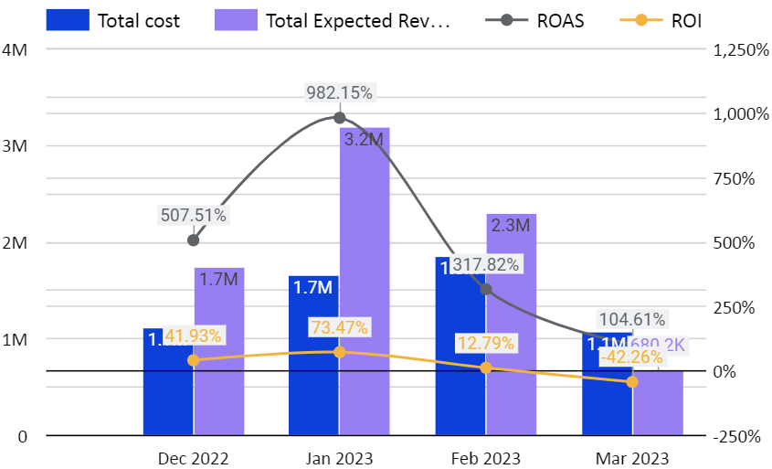
High-Level Overview
Please review this slide on presentation mode
Are our campaigns & target audience saturated?
(Costs increased and CR% fell)
Let’s start to drill down, firstly understanding conversion rates of each part of the Student Funnel
21.5% was the E2E Return of Investment - above industry average*
However, as a result of decreasing Sales and rising Costs, from Jan onwards ROI and ROAS substantially decreased.
Revenue for each month not only drops, but what is most concerning, lands below cost levels in March erosioning profit.
Evolution of Revenue vs Costs
*OCED Reference for educational projects: 10-20%
See Costs Evolution through time here
See Customer Acquisition Cost here
Notes:
Explicar el primer gráfico.
The ROI for the overall business evaluated over the four months gives 21.48%. According to some notes consulted (from the OECD -Organisation for Economic Co-operation and Development- and the World Bank) the ROI of a business in the educational area is usually between 10% and 20%.
So, in principle, this value would be within the expected range.
Lets understand CR!

Slide 7
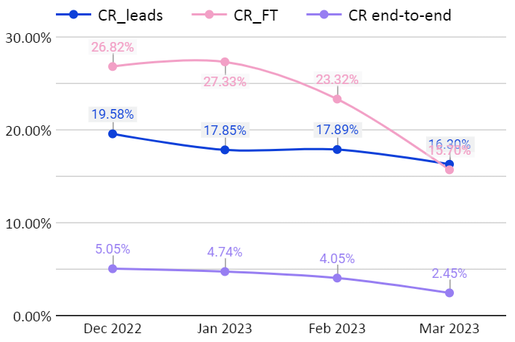
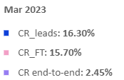
4%
of each Lead ended up with a Contract (Average CR%)
However, consistently dropped from 5,1% in Dec to only 2.5% in Mar.
As biggest drop is on Free Trial CR% a deep-dive is critical
Is it driven by our sales team performance? Is it channel mix?
CR’s evolution from Dec to Mar
Notes:
Explicar qué significa ese 4%. Decirlo.
Es malo? Bueno? Es avg? Bueno, cuando lo vemos por partes, vemos cosas interesantes. Hacer preguntas que sean para después!
Is it driven by our sales team performance? Is it channel mix? Para eganchar

Slide 8
Further focus on commercial strategy is needed.
Understanding our students is key.
Are we offering our trial-students the packs they aim to have?
(e.g. shorter subscriptions)
There is a big amount of Leads that have not been called even once (~13k)
But it isn’t all bad news.
-On the commercial side,
the average amount of call attempts per lead goes down a bit as well as the average total call duration.
This could mean that over the months sales teams have learned and improved the way they convey the message.
-Sales Pitch is trying to be improved a we conducted an A/B testing showing CR improvement of 0.62% with minimal cost increase
Notes:
2) Imagina la frustracion de que dejaste el lead y no te llamaron!
Y si tenemos en cuenta el 4% de CR, son aprox 500 estudiantes que perdemos! That’s massive!
De hecho, realizamos un A/B test que analizaremos más adelante, pero que demostró que se obtiene una mejora del 0.62% con minimos costos.
Les puedo contar sobre el A/B test, quieren detalles?

Slide 9
is Sales Pitch important?
Yes!
Please review this slide on presentation mode
The hypothesis that ‘Pitching on test sessions does not have an impact on the CR’ is rejected, so the hypothesis of the statement is accepted.
The test group has a CR improvement of 0.62%, which means 2054 new customers for the period analyzed.
The difference in minutes between groups is 0.2544 minutes per call, which represents €0.4313 per call.
The initiative should be adopted & further scaled, as the cost associated with including the sales pitch is negligible compared to the potential gain.
Notes:
Este código realiza una prueba z de dos proporciones (two-proportion z-test) para comparar las tasas de conversión entre dos grupos (por ejemplo, un grupo de prueba y un grupo de control). Aquí te explico en detalle qué es, sus supuestos y por qué se usa:
Tipo de Evaluación:
La prueba z de dos proporciones se utiliza para determinar si las proporciones de éxito (conversión, en este caso) entre dos grupos son significativamente diferentes entre sí. Es un contraste de hipótesis que compara dos proporciones poblacionales para evaluar si la diferencia observada en las muestras es estadísticamente significativa.
Hipótesis:
Hipótesis nula (H0H_0H0​): Las proporciones de conversión en los dos grupos son iguales (no hay diferencia en las tasas de conversión).
Hipótesis alternativa (HAH_AHA​): Las proporciones de conversión en los dos grupos son diferentes.
Supuestos:
Independencia: Los grupos deben ser independientes, es decir, no debe haber superposición entre los sujetos en cada grupo.
Normalidad aproximada: La prueba z asume que las distribuciones de las proporciones de éxito se aproximan a una distribución normal. Esto es razonable cuando ambos grupos tienen tamaños de muestra suficientemente grandes (usualmente n⋅p^>5n \cdot \hat{p} > 5n⋅p^​>5 y n⋅(1−p^)>5n \cdot (1 - \hat{p}) > 5n⋅(1−p^​)>5, para cada grupo).
Muestras aleatorias: Los datos deben ser una muestra aleatoria representativa de la población.
from statsmodels.stats.proportion import proportions_ztest
# Step 1: Set up the data for statistical testing
# Number of conversions in each group (successes)
conversions = [test_group_customers, no_test_group_customers]
# Total leads in each group (sample size)
leads = [test_group_leads, no_test_group_leads]
# Step 2: Perform a two-proportion z-test
z_stat, p_value = proportions_ztest(conversions, leads)
# Step 3: Output the z-statistic and p-value
print(f"Z-Statistic: {z_stat:.2f}")
print(f"P-Value: {p_value:.5f}")
# Step 4: Interpret the result
alpha = 0.05 # Common significance level (5%)
if p_value < alpha:
print("Reject the null hypothesis: There is a significant difference in conversion rates.")
else:
print("Fail to reject the null hypothesis: No significant difference in conversion rates.")

Slide 10
Channel Analysis
As each channel has different dynamics in reality, let's zoom-in on each one to better assess the situation.
Notes:
Dijimos que la caida podía ser por sales o por el mkt estrategy.Veamos ahora el mix.

Slide 11
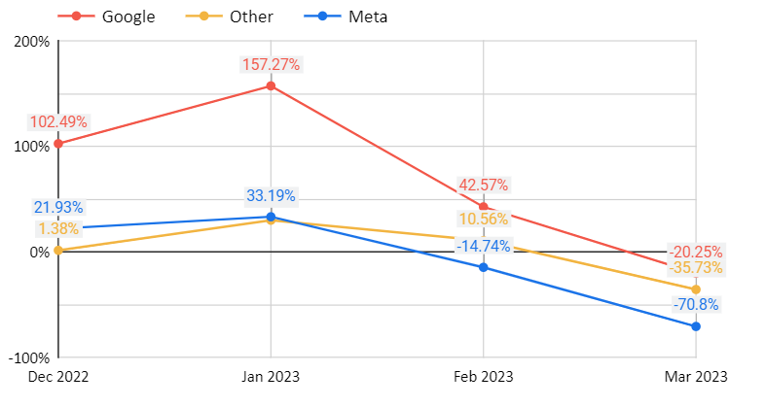
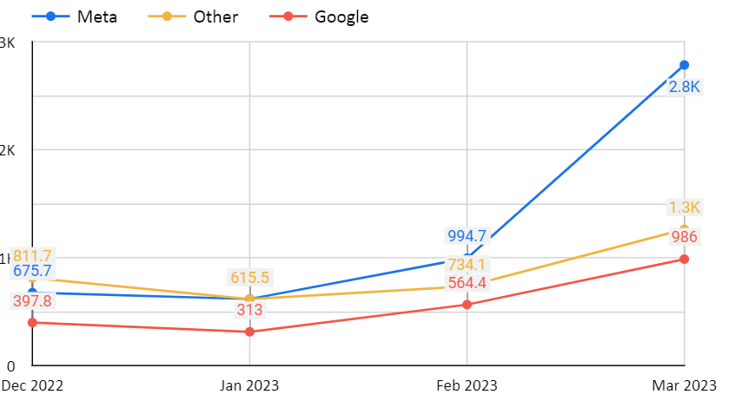
Channel Return of Investment
ROI drops for all channels as Cost per acquisition skyrockets but drastically on META, where costs have increased x5 times in 5 months.
Lets look at conversion rates too to have a more complete picture
ROI per channel
Cost of Adquisiton per channel
See ROAS here
Notes:
Las mals noticias son que el Roi cae, y esto se explica porque los costos se quintuplican.
a high percentage of the target audience was covered, and in the following months the cost of reaching the remaining target audience has grown exponentially. Another possibility is that the content of the campaign has not changed sufficiently, and the audience has quickly reached saturation.

Slide 12
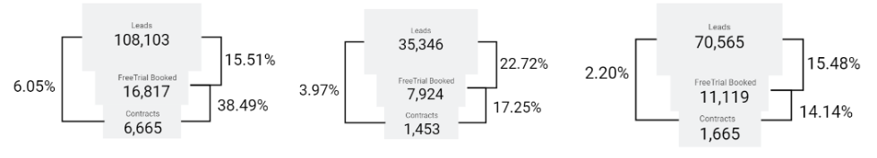
Funnel Conversion by Channel
Others
Please review this slide on presentation mode
Deep-dive into this type of student and understand its expectations through a Survey or Focus Group
This a very unusual behavior in general, and would be smart to use this, prioritizing pitches and calls to Google’s Leads.
It would be good to improve Other's tracking because the investment allocated is not minor and certain KPIs are better vs META
Google has the
best CR% end-to-end
and specially FreeTrial-to-Customer
Meta is great for penetration (to get students who are willing to accept the free class), but then CR% drops
Others at first glance seems to have low CRs%, but converts with lower costs vs Meta
Channel volume contribution
here
See ROAS here
Notes:
Puedo explicar mínimo que funnel usé. Contar todo junto channel by channel asi nose pierden.
And something quite interesting is that contrary to what usually happens Google’s CR_FT over duplicates from CR_leads (15,51% to 38,49%). This a very unusual behavior in general, and would be smart to use this, prioritizing pitches and calls to Google’s Leads.
A suggestion could be to deep-dive into this type of student and understand its expectations through a Survey or Focus Group. (Price or Duration might not be convenient, e.g. Students from Social might be looking for a 1-month subscription only instead of 6/12/24 months).

Slide 13
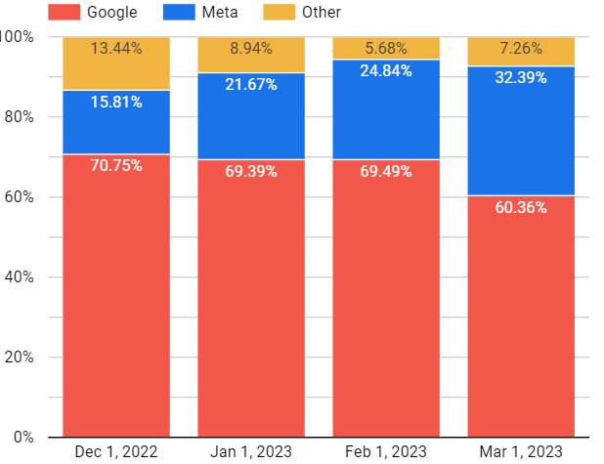
Channel mix
With this information at hand, how well did we invest?
Meta Share of Biz increased month after month.
This means, we invested more in a channel with not so good CR% & highest cost per adquisition
Share of marketing investment
See Customer Acquisition Cost per channel here
See share of Leads here
Notes:
Con esto alcanza, pero si querés más podemos deep dive en share of leads and so on. Pero lo más importante que les puedo decir hoy es que podemos hacer:
When we analyze the mix of mkt investment over the months, we see that it remained more or less constant at around 70% for Google, but that it was decided to increase Share of investment in Meta. However, contrary to this increase, the channel with the lowest cost of acquisition (CAC) was Google.
It was decided to invest to a channel with CR not so good and no that effective in driving conversions.

Slide 14
Action items
What we can do?

Slide 15





Task 1 - Action items
Please review this slide on presentation mode
Optimize Channel Mix & Prioritize calling and pitching Google’s Leads and Leads that have not been called even once.
See opportunity in numbers here
Perform an audit to Free Trials and implement an action for the Professors (commission for new customer, sales training, etc).
+ Priority -
Conduct a focus group on Meta’s Leads to understand them better.
Review and improve campaign tagging to disaggregate Other channel.
Explore alternatives in terms of the current target audience, to improve remarketing, to analyze the convenience of testing other markets.
Notes:
Just look at the number of Leads who took the FreeTrial (CR_leads) and the number of Leads who took the class and signed up for the service (CR_FT). Let's complete with the overall CR, i.e. the % of Leads that became customers. What we see is a general downward trend, which makes sense, since at the beginning of our campaign we are impacting more interested users, which means that over the following months, we will be left with less convinced users, and this means that the transition to customers is not so direct. However, the quality of Leads obtained by Google is the best, as it has the best CR and CR_FT.

Slide 16
Thank you!
I will be happy to answer your questions at:
gonzalohernandez1990@gmail.com

Slide 17
Appendix
If you want to see the full analysis, read the complete document here.

Slide 18
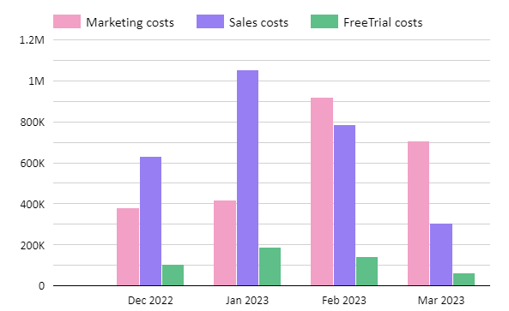

Sales costs exceed mkt cost in the first 2 months.
Mkt costs increased over time.
Costs Evolution through time
Back
Notes:
On the Costs side, In the first two months, sales costs exceed mkt costs. This may be due to the sales team ramping up and at the same time, as investment in Reach (marketing) grows, we also saturate our target audiences, and greater efforts/costs will be required on the mkt side.

Slide 19
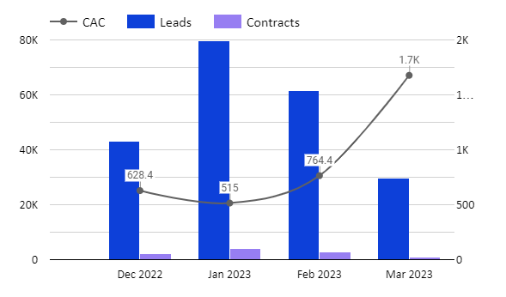
Customer Acquisition Cost skyrockets (almost 3 times higher)
Leads and Customers are more and more expensive and hard to get
Customer Acquisition Cost
Back

Slide 20
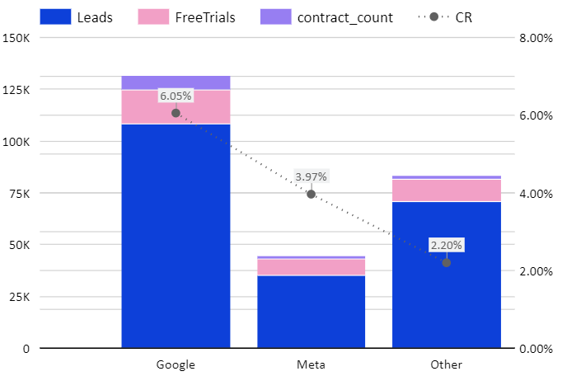
Channel volume contribution
Back

Slide 21
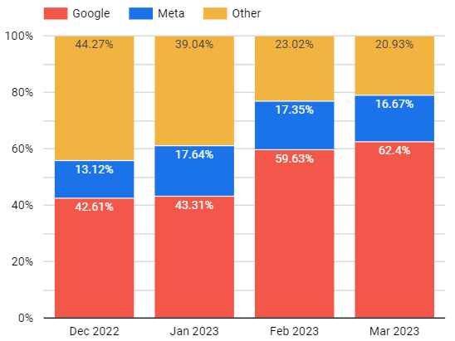
Although the increase in mkt efforts, Meta maintained its share
Share of Leads
Back
Notes:
One possibility is that at the beginning of the campaign, a high percentage of the target audience was covered, and in the following months the cost of reaching the remaining target audience has grown exponentially. Another possibility is that the content of the campaign has not changed sufficiently, and the audience has quickly reached saturation.

Slide 22
Google has the lowest CAC over time.
Investment was made on Meta, which has the highest CAC in general
Customer Acquisition Cost per channel
Back

Slide 23
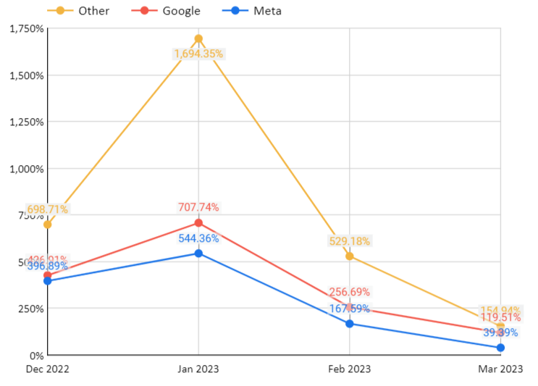
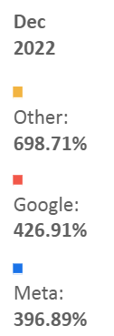
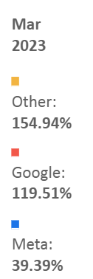
ROAS per channel
ROAS per channel
Back
Notes:
When we analyze the mix of mkt investment over the months, we see that it remained more or less constant at around 70% for Google, but that it was decided to increase Share of investment in Meta. However, contrary to this increase, the channel with the lowest cost of acquisition (CAC) was Google.
It was decided to invest to a channel with CR not so good and no that effective in driving conversions.

Slide 24
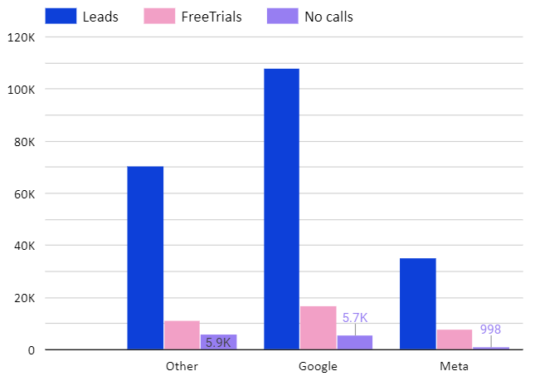
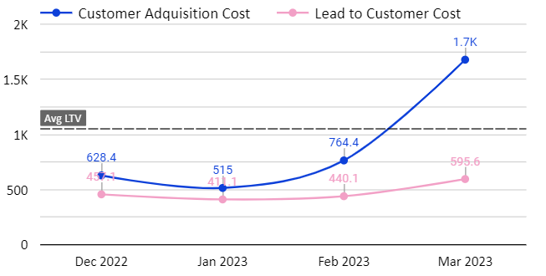
Opportunity in Leads that have not been called even once.
Worthwhile to reinforce the efforts to call these Leads
No-called Leads Opportunity
Back
Notes:
When we analyze the mix of mkt investment over the months, we see that it remained more or less constant at around 70% for Google, but that it was decided to increase Share of investment in Meta. However, contrary to this increase, the channel with the lowest cost of acquisition (CAC) was Google.
It was decided to invest to a channel with CR not so good and no that effective in driving conversions.

